Slide 1
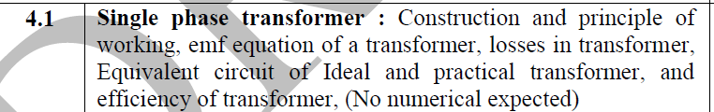
4.1-Transformers

Slide 2
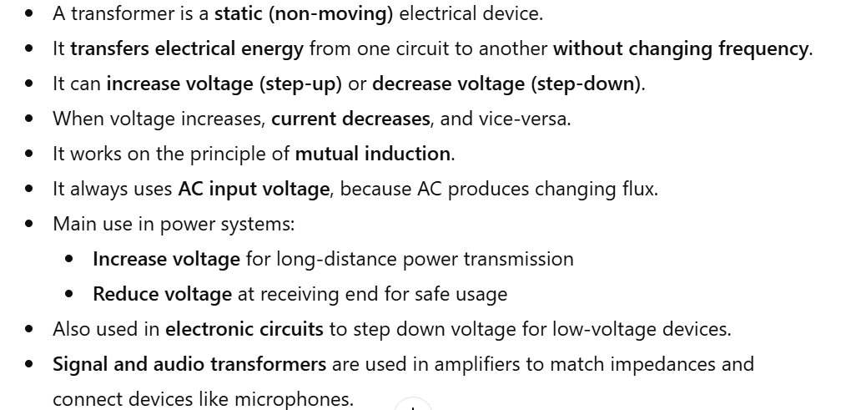
Transformer

Slide 3
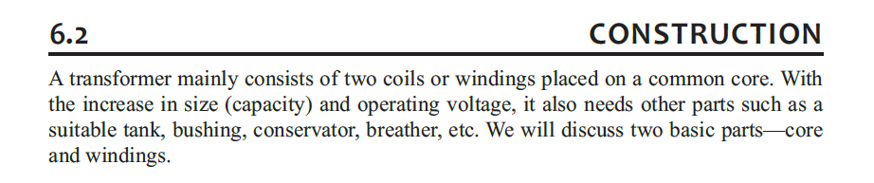

Slide 4
Transformer Core
The transformer core is made of thin steel laminations stacked together.
Laminations are coated with varnish/oxide to provide insulation.
Limits the flow of eddy currents, reducing eddy-current losses.
Uses high-grade silicon steel to minimize hysteresis loss.
Provides a continuous magnetic path for efficient flux flow.
Common shapes: E-I core and U-I core.
Laminated design improves efficiency and reduces heating.

Slide 5
Generally, air-core transformers are used when the voltage source has a high frequency (above 20 kHz).
Iron-core transformers are usually used when the source frequency is low (below 20 kHz).

Slide 6
Transformer Windings
A transformer has two windings: Primary winding – receives electrical input Secondary winding – delivers output to the load
Both windings are made of insulated copper wire (round wire or copper strip).
Windings are placed on the limbs of the core.
Insulated from each other and the core .

Slide 7
Leakage Flux & Winding Arrangement
If windings are placed on separate limbs, not all flux links the secondary.
The flux that escapes through air is called leakage flux.
More leakage flux → poorer transformer performance.
In practical transformers, primary and secondary windings are placed on the same limb to reduce leakage flux and improve efficiency.

Slide 8
Working principle:-How Flux is Produced in a Transformer
When AC voltage is applied to the primary winding, AC current flows through it.
This AC current produces a changing magnetic flux in the core.
The production of magnetic flux by current is based on Ampere’s Law.
According to Faraday’s Law, a changing magnetic flux induces an emf.
Therefore, the changing flux in the primary winding induces an emf e₁ in the primary coil.
Simple sequence: AC Voltage → AC Current → Changing Flux → Induced emf (e₁)

Slide 9
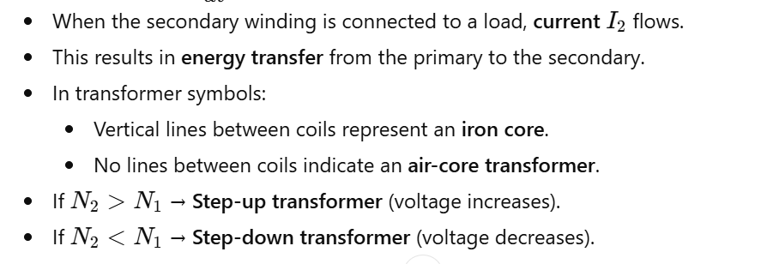
Working principle

Slide 10
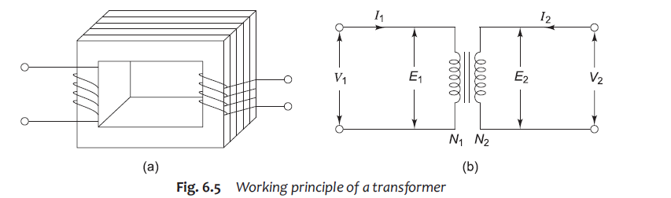
Diagram to Explain Working Principle(Representation of a transformer)

Slide 11
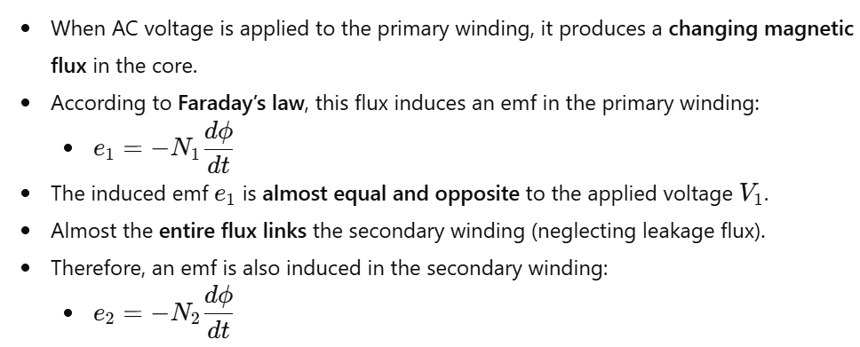
Transformer working principle..

Slide 12

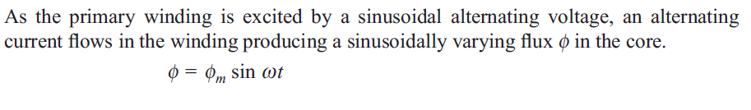
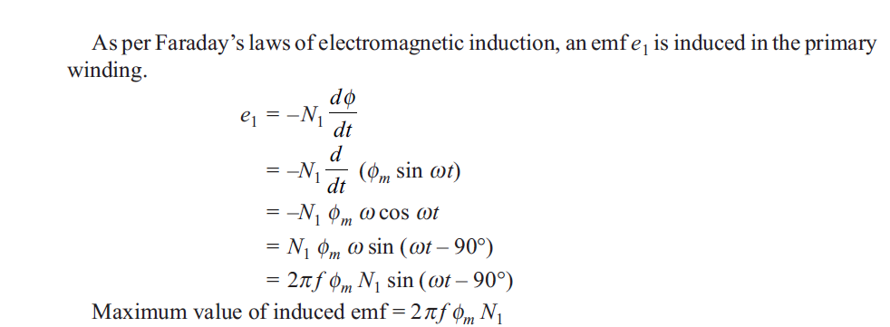

Slide 13
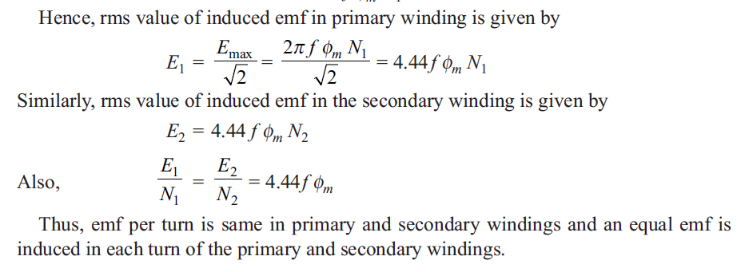
EMF Equation

Slide 14
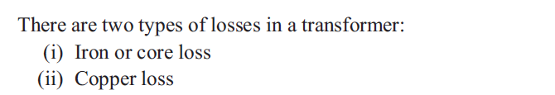
Iron Loss
Iron loss happens inside the iron core of a transformer.
It occurs because the magnetic flux keeps reversing many times per second.
The flux in the core stays almost constant, whether the load is small or large.
So, iron loss is also almost constant from no-load to full load.
At no-load, the primary current is very small, so copper loss is almost zero.
Therefore, the losses at no-load are mainly iron losses.

Slide 15
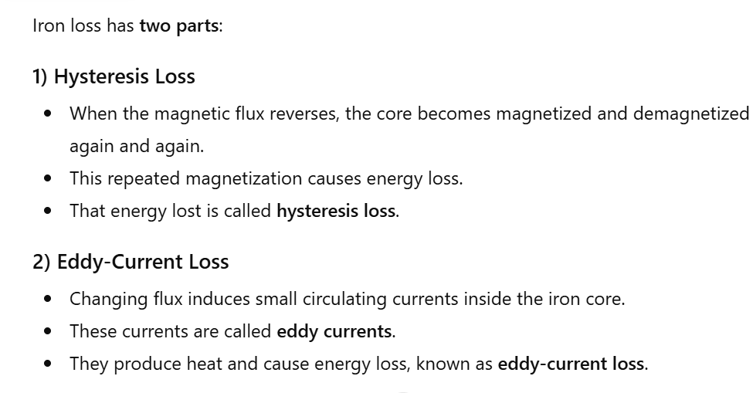

Slide 16
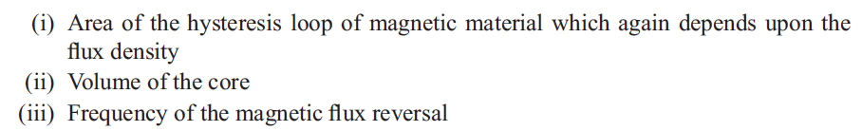
Hysteresis Loss
Hysteresis loss depends on the following factors:-

Slide 17
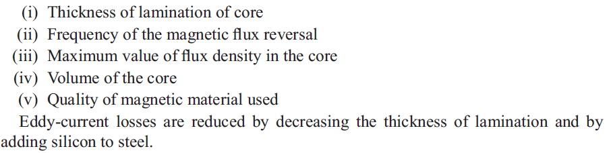
Eddy current Loss
Eddy Current Loss depends on the following factors:-

Slide 18
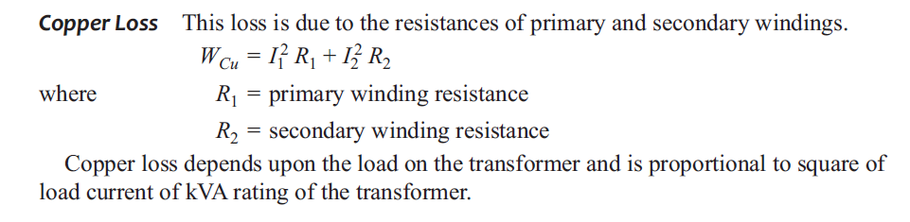
Copper Loss

Slide 19
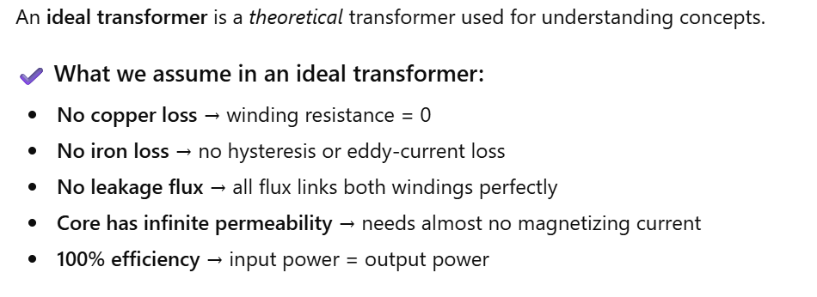

Slide 20
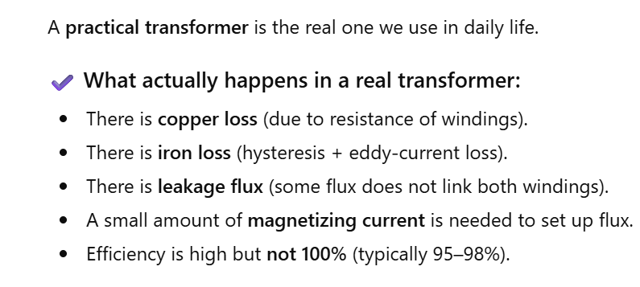

Slide 21
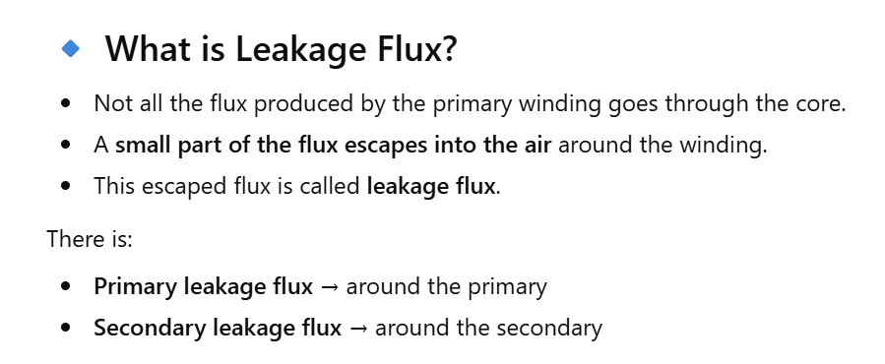

Slide 22

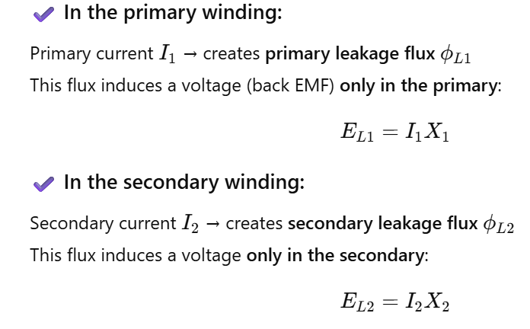

Slide 23
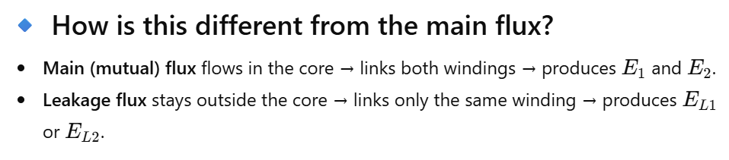
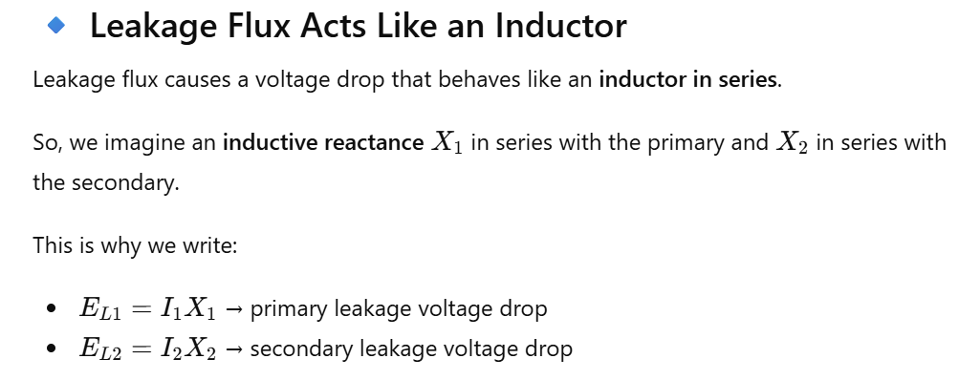

Slide 24
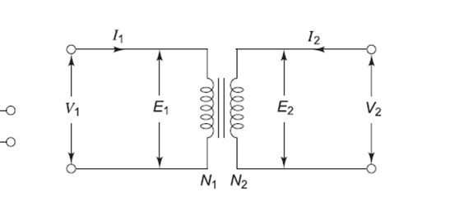
Equivalent diagram of an Ideal Transformer

Slide 25
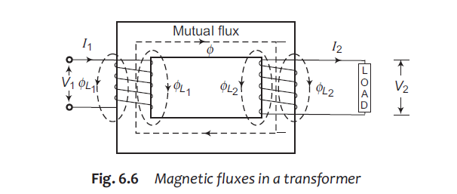
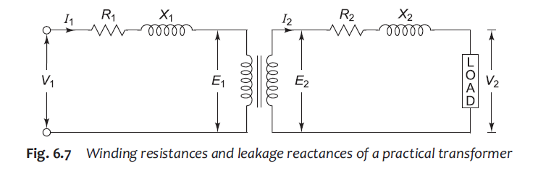
Equivalent diagram of a Practical Transformer

Slide 26
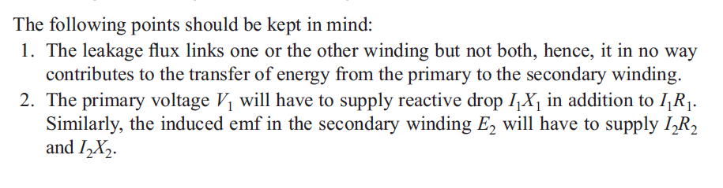

Slide 27
